Slide 1
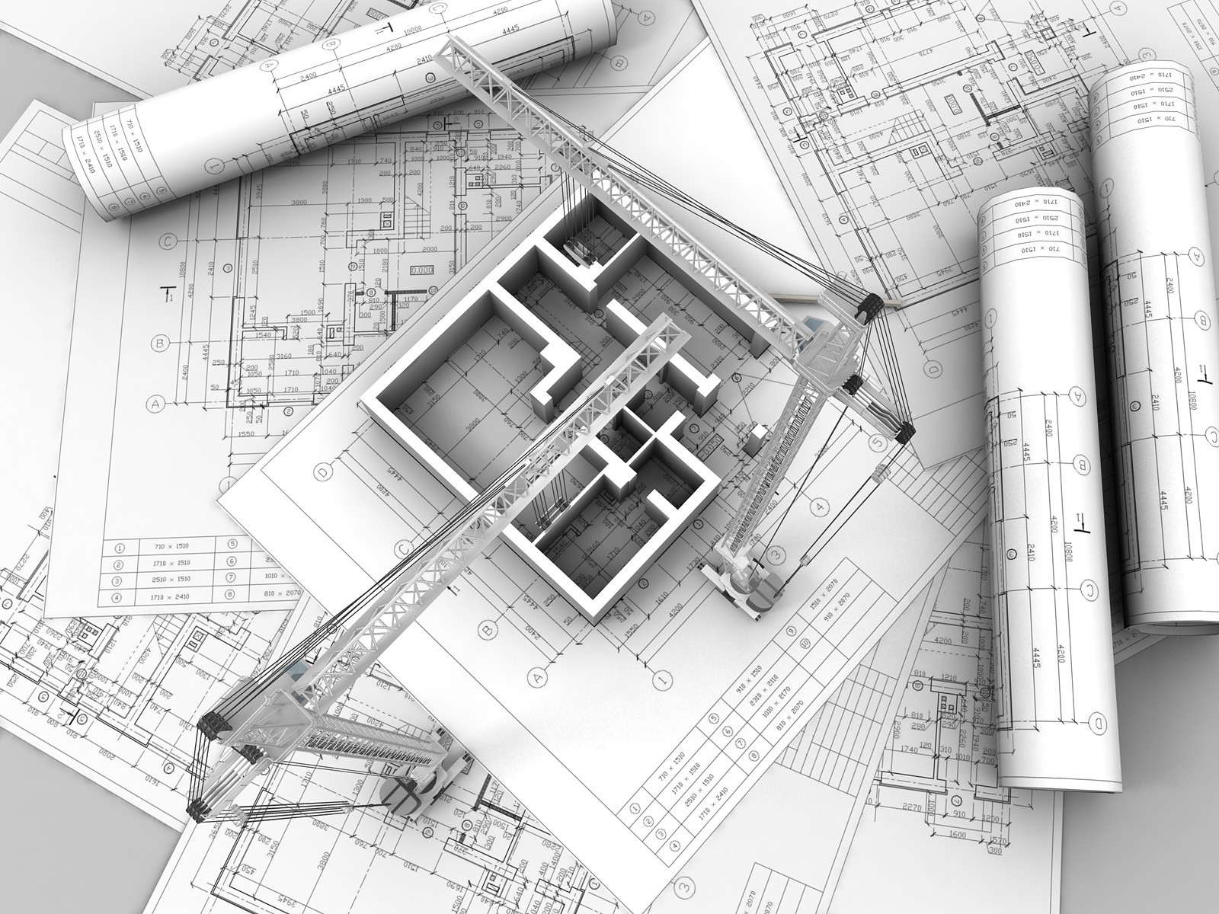
Documenting Architectures 718304: Software Architecture

Slide 2
Related Course Outcomes
Independently select or design architectures for complex software systems and clearly document non-trivial software architectures.
Critically evaluate different software architectures and analyse their advantages and disadvantages.

Slide 3
How would YOU document an Architecture?

Slide 4
Overview
General rules for documenting architectures
Documenting a view
View set
Documentation across views
Case study – IoT Architecture

Slide 5
Documenting architectures
Exam-relevant
Major roles of architecture:
Allows groups of people to work cooperatively and productively together
It’s “divide and conquer” followed by “now mind your own business” followed by “so how do these things work together”
Architecture documentation:
Tells developers how to make the sets of parts work together as a successful whole
Communicates the achievement of those engineering goals

Slide 6
Three fundamental uses of architecture documentation:
1. Education
New members of the team, external analysts, new architect, etc.
2. A vehicle for communication among stakeholders
3. The basis for system analysis

Slide 7
Some general rules
Exam-relevant
Define and state the target audience, and make sure the content is relevant to that audience
Keep Document only as little as possible.
Avoid duplication:
Document every aspect in one place only – and use links to connect related topics
Put documentation into the version

Slide 8
Always document top down (you may design the system bottom up)
Provide progressively more details only for those readers who want to actually know them
Make sure concepts and the big picture is understandable without rummaging through all the details!
Visualization (one “picture” is better than 100 words)

Slide 9
Question
What is a view?
What is a viewpoint?

Slide 10
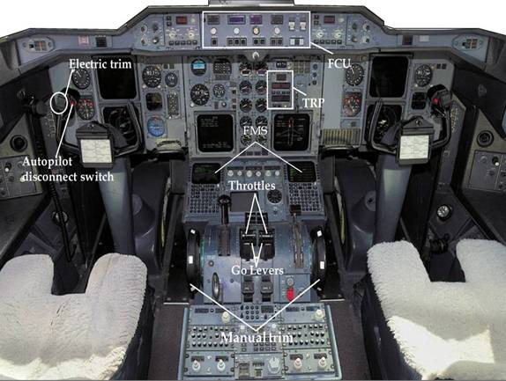




Views
A view is a representation of coherent set of architectural elements, as written by and read by system stakeholders
Why we need views?
Software architecture: the structure or structures of the system which comprise elements, the externally visible properties of those elements and relationships among them
You need to communicate your design with
different stakeholders
The system can be very complex
Different stakeholders care about different things

Slide 11
Documenting a view
Exam-relevant
No industry-standard template for documenting a view
7-part standard organisation (Len Bass, et al.)
Primary presentation: shows the elements and the relationships among them
Normally graphical
You can adopt an existing modelling tool/language, e.g., UML, Petri Net, …
Sometimes can be tabular, especially when there are a large amount of information needs to be included
Explanation about notation and symbols used should be included

Slide 12
2. Element catalog: details the elements and relations depicted in the primary presentation.
Elements and their properties
Relations (with other elements)
Element interface: how it interact with the outside world
Element behaviour
3. Context diagram: shows how the system depicted in the view relates to its environment.
4. Variability guide: shows how to exercise any variation points that are a part of the architecture shown in this view.

Slide 13
5. Architecture background: explains why the design reflected in the view came to be
Rationale: explaining why this decision is made? Why not other alternatives?
Analysis results: justification of the design (decision)
Assumptions reflected in the design
6. Glossary of terms
7. Other information:
Authorship
Versions
Change history
References
…
Any information which is not architectural

Slide 14
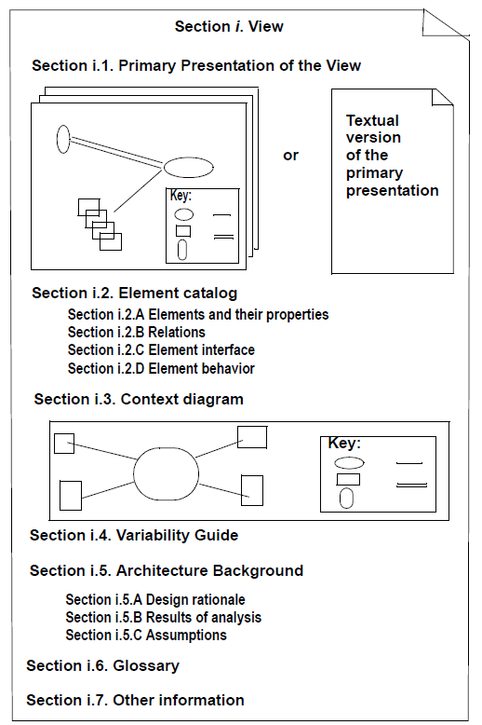
Exam-relevant
View documentation Template:
Example of view documentation:
https://wiki.sei.cmu.edu/sad/index.php/The_Java_Pet_Store_SAD

Slide 15
Viewsets
Documenting an architecture is a matter of documenting the relevant views and then adding documentation that applies to more than one view
Structural
Behavioural
External
Developable

Slide 16
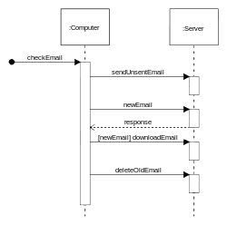
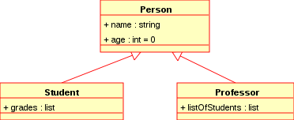
Viewsets
“4+1” approach: 4 main views of software architecture that can be used to great advantage in system [Philippe Kruchten]:
The logical view: is concerned with the functionality that the system provides to end-users, and decomposition of the system into a set of key abstractions (e.g., objects or object classes)
For example: UML Class diagrams and Sequence diagrams

Slide 17
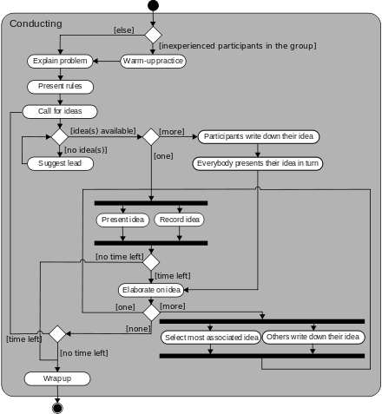
2. The process view: deals with the dynamic aspects of the system
Explains the system processes and how they communicate, and focuses on the runtime behaviour of the system
Addresses concurrency and distribution, system integrity, and fault-tolerance
Specifies which thread of control executes each operation of each class identified in the logical view
Example: UML Activity Diagrams

Slide 18
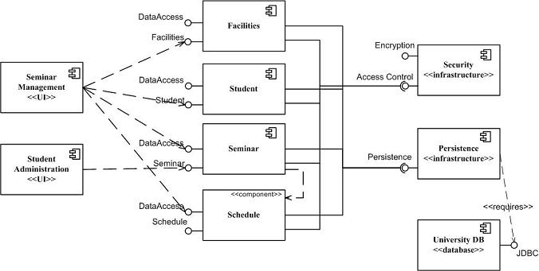
3. The development view: illustrates a system from a programmer's perspective and is concerned with software management. Also known as the implementation view.
Focuses on the organization of the actual software modules in the software-development environment
Supports the allocation of requirements and work to teams,
Supports cost evaluation, planning, monitoring of project progress, and reasoning about software reuse, portability, and security
Example:
UML Component Diagram

Slide 19
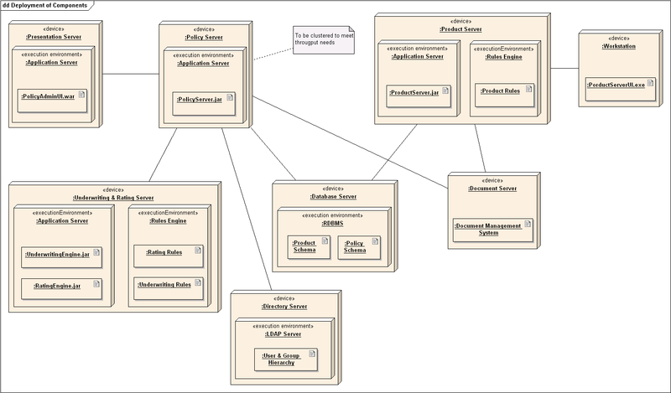
4. The physical view: depicts the system from a system engineer's point-of-view. It is concerned with the topology of software components on the physical layer, as well as the physical connections between these components. Also known as the deployment view.
Takes into account the system's requirements (e.g., availability, performance, and scalability)
Maps the various elements identified in the logical, process, and development views (e.g., networks, processes, tasks, and objects) onto the processing nodes
Example:
UML Deployment Diagram

Slide 20
5. Using a small subset of important scenarios (i.e., instances of use cases) to show that the elements of the four views work together seamlessly
Exam-relevant
4+1
Logical View
Development View
Scenarios
Process View
Physical
View

Slide 21
What should be included in an architecture document?
Software Architecture for System XYZ
Section 1: View 1
Section 2: View 2
Document across views
Section n: View n
=
+
Documenting an architecture is a matter of documenting the relevant views, and then adding documentation that applies to more than one view

Slide 22
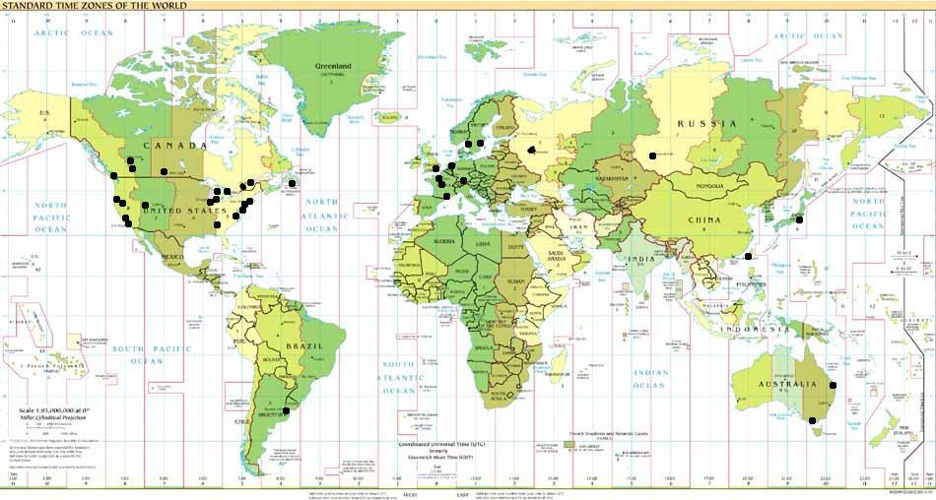
Documentation across views
An architecture is to a system what a map of the world is to the world
In a Map
In a Architecture Document
Continents, oceans, mountains, lakes, rivers, …
View documents
Cartouche, distance scale, compass roses, wind-heads, …
Cross-view documents

Slide 23
Cross-view documentation consists of 3 major aspects, which we can summarize as how-what-why:
How the documentation is laid out and organized
What the architecture is
Why the architecture is the way it is
(Structured) Glossaries

Slide 24
How the documentation is laid out and organized
Facilitate a stakeholder to find the information he/she needs
Contain:
A view template
A view catalog
What the architecture is
A short system overview to ground any reader as to the purpose of the system; the way the views are related to each other; a list of elements and where they appear; and a glossary that applies to the entire architecture
Contains:
System overview
Mapping Between Views

Slide 25
Why the architecture is the way it is: rationale
Explain how the overall architecture is in fact a solution to its requirements:
The implications of a design choice on meeting the requirements or satisfying constraints
The implications on the architecture when adding a foreseen new requirement or changing an existing one
The constraints on the developer in implementing the solution
Decisions alternatives that were rejected
A glossary lists the relevant architectural concepts and their meaning and relationships
Example:
Data type | Represent a certain chunk of data. Data type can either be simple types (e.g., string, int) or Complex Types
Component | A component is a well-defined piece of behaviour. It does not implement technical concerns. Each component can provide a number of Interfaces. It can also use a number of interfaces (provided by other components)
Interface | A contract that contains a number of operations; operations are defined in the usual way (parameters, return type, exceptions)

Slide 26
Structured glossary:
Data Type
1 is of type 1..n
Parameter
1..n
has
Simple Type
Complex Type
1
Operation
1..n
has
1
Component
1 provide 1..n
Interface
1..n
1..n
trigger
invoke
1..n
1..n
Process

Slide 27
Exercise
The IoT Architecture

Slide 28
References:
Kruchten, P., “The 4+1 View Model of Architecture,” IEEE Software, 12(6):42-50, 1995
Soni, D., R. Nord, C. Hofmeister, “Software Architecture in Industrial Applications,” Proceedings, International Conference on Software Engineering, April 1995, pp. 196-210
Chapter 9, Len Bass, et al., Software Architecture in Practice, Pearson Education Inc., 2009
https://wiki.sei.cmu.edu/sad/index.php/The_Java_Pet_Store_SAD

